Slide 1
Unethical Behavior
Two-Part Frontline Documentary: “The Facebook Dilemma”

Slide 2
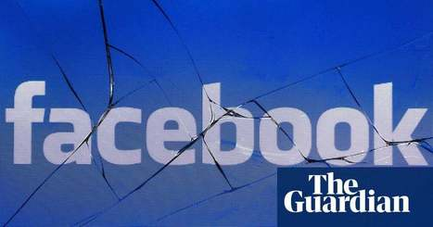
Introduction
The Facebook Dilemma,” attacks the moral issues.
The documentary shows the dilemma which faces the organisation (Brügger, 2015).
Automated reverberation promises to fix the issue sounded unconvincing.
Facebook extended so quickly the organization was unable to keep pace with it.
Notes:
The documentary shows the dilemma which faces the organisation as it does not know what to do to resolve its scandals (Brügger, 2015). However, automated reverberation makes promises to fix the issue sound unconvincing. Again, Frontline chases down nine former Facebook staff members, just as a large group of writers and scholastics.

Slide 3
Facebook as an Organization
Facebook is an organization which provides social media services.
The developer is John Zuckerberg and was later joined by his friends.
The organization has more than two billion clients (Copp, 2017).
Currently, the organization liaises with other platforms like Google, online libraries, etc.
Notes:
The developer of the platform is John Zuckerberg, a nonce student at Harvard University (Copp, 2017). He first tested the platform with his friends Eduardo Saverin, Chris Hughes, and Dustin Moskovitz. The organization has more than two billion clients. It earns from sales pages created to advertise market items.

Slide 4
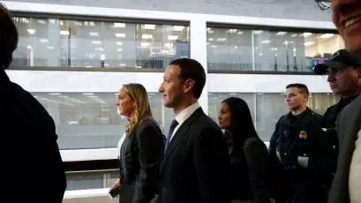
Facebook as an Organization (Cont..)
The CEO of the organization always urges people to provide accurate details about themselves (Brügger,2015).
Majority of the organization clients are the youth who are very active with social media.
Facebook platform enables new members to create personal accounts.
Personal accounts allow communication.
Notes:
Majority of the organization clients are the youth who are very active with social media. They spend a lot of time exchanging information with one another regardless of the places they are. The youths are also actively selling their market items using the platform (Brügger 2015).

Slide 5
The Main Organizational Actors
Management team (Copp, 2017).
Support team.
Account holders.
Business organizations.
Notes:
The actors of the organization are; management team, support team, account holders and business organization (Copp, 2017). However, the victims of the organization's unethical situations include individuals, the general community and the state. All the actors are meant to improve the platform and make it more successful.

Slide 6
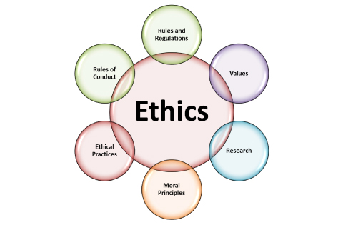
The Unethical Situations
The association faces outrages for meddling into individuals' privacy.
It also neglected to maintain polished skill in managing delicate issues in their online life (Copp, 2017).
Members of the US Congress accuse the organization of having leaked information about the 2016 US elections to the Russian state.
Some information leaked to an Australian newspaper about the organization.
Notes:
Online platforms such as Facebook should promote ethical concerns among its followers in order to maintain the professionalism they have with their customers. In addition, maintaining privacy and confidentiality is a vital ethical aspect that should be always be practiced by the platform (Copp, 2017).

Slide 7
Why the Actions Are Unethical and Their Effects to the Party Offended
The Facebook organization committed a professional mistake because it liaised with people with ill- intentions about the states.
The organization did not observe ethics when selling people’s information to advertising businesses (Rodriguez & Obradovac, 2017).
Normative ethics were not observed.
Facebook does not ask permission to the honours of the details they sell to the third party.
Notes:
Facebook’s topmost officials embrace moral decadency by selling information of clients and the state to another party. The organization should be patriotic enough to safeguard the welfare of its clients. Therefore, all the stakeholders in the organization must uphold ethics (Rodriguez & Obradovac, 2017).

Slide 8
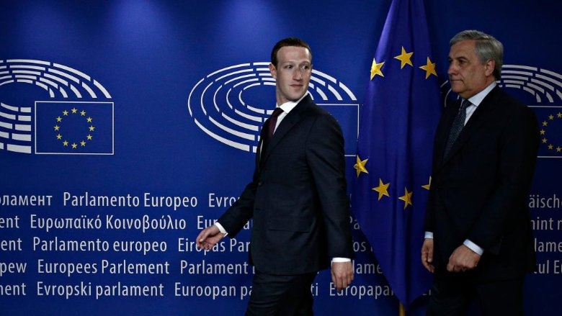
Why the Unethical Situation Occurred
Unethical situations occurred because the organization's topmost officials do not uphold organizational behavior (Rodriguez & Obradovac, 2017).
The general public does not notice that their details leaks to a third party.
The officials want to maximize profit, which they tap from their clients.
The public’s privacy is violated.
Notes:
The officials regard their identity as hidden, and as such, the general public can not notice that their details leaks to a third party (Rodriguez & Obradovac, 2017). The reasons why the unethical mistakes happen are that the officials want to maximize profit, which they tap from their clients.

Slide 9
Factors that Facilitated the Occurrence of Unethical Situations
Poor observance to organizational behavior.
Lack of professionalism (Rodriguez & Obradovac, 2017).
Poor leadership.
The management should aim to address these issues to promote ethics.
Notes:
The unethical situations bring about adverse effects to the organization because it will lose customer loyalty and therefore, face some downturns (Rodriguez & Obradovac, 2017). On the side of the victim, the condition causes emotional turmoil, interpersonal enmity, and insecurity of the state’s political matters.

Slide 10

Conclusion
Facebook should not share data to third parties.
It should protect information fed in their network by individuals and the general public.
Selling of information to the third parties is unethical.
Facebook should avoid giving state enemies crucial information.
Notes:
In summation, “the Facebook dilemma” will only resolve if the organization ensures regulation of the information getting in the platform. They should also protect information fed in their network by individuals and the general public to promote ethical aspects.

Slide 11
References
Brügger, N. (2015). A brief history of Facebook as a media text: The development of an empty
Copp, D. (2017). Normative naturalism and normative nihilism: Parfit's dilemma for naturalism.
Rodriguez, J. T., & Obradovac, I. (2017). Comparative study on user's perception of privacy issues on Facebook: Young adults vs. adults in Sweden.

Slide 12
Presented by;

